Slide 1

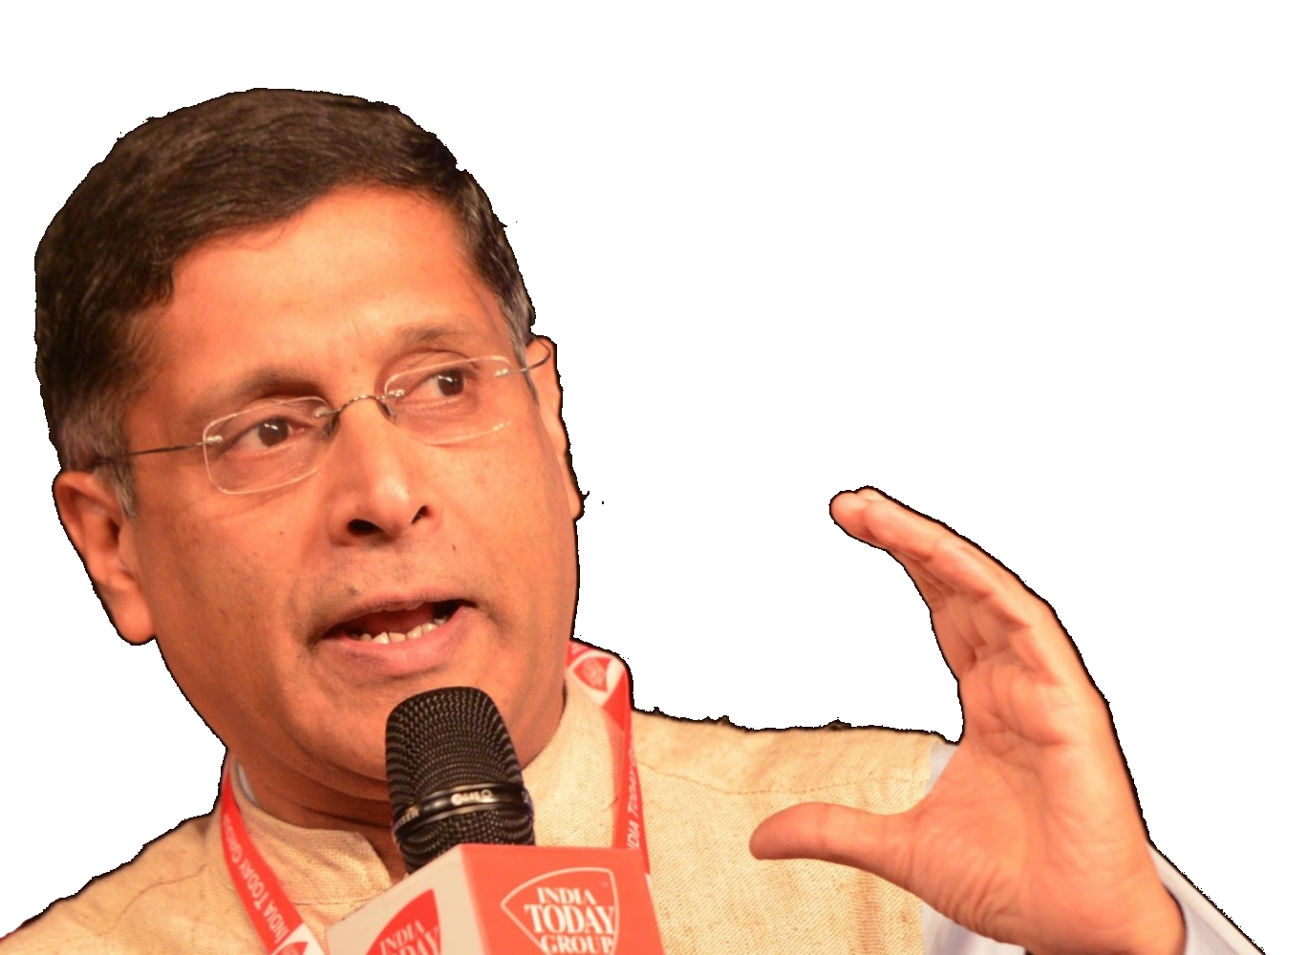

In February 2016
Past Observations (Vol2)
Future Suggestions (Vol1)
Most Some suggestions accepted
Past Data
Future Plan
1st April 2016
Tax collection & Expenditure
31st March 2017

Slide 2

Theory +Economic Survey Vol.2 + Vol.1 + Budget 2016
1.Banking Finance
6.HRD
2.Budget-Fiscal Policy
3.BoP
4.Sectors of Economy
5.Infra
V2C2-Pub.Fin; V1C3-JAM
V2C3-Monetary mgmt+FI
V2C4-External sector
V2C5-Price,Agri.; V2C6,7
V2C8-Paris Summit, Energy
V2C9-Social infra.
V1C4-Agri ; V1C9-Fertilizer
V1C5-mother-child
V1C6-bounties; V1C7-Fiscal Cap
V1C8-PTA
V1C2-Chakravy; V1C10-Labour
V1C11-Powering 1 India
B1. Financial Sector Reforms
B2. Fiscal Discipline
B3. Tax Reforms; B4. Ease of
B5. Agro: 2x farmer income
B6. Rural infra-employment
B7. Infrastructure
B8. Social Sector & healthcare
B9. Education, Skills, Jobs
V2C1- Chakravyuh challenge
V1C1- Twin Balancesheet
+Survey Ch.1s Spread throughout; SDG-Goal esp. @#4,5,6; HDI Report@6

Slide 3
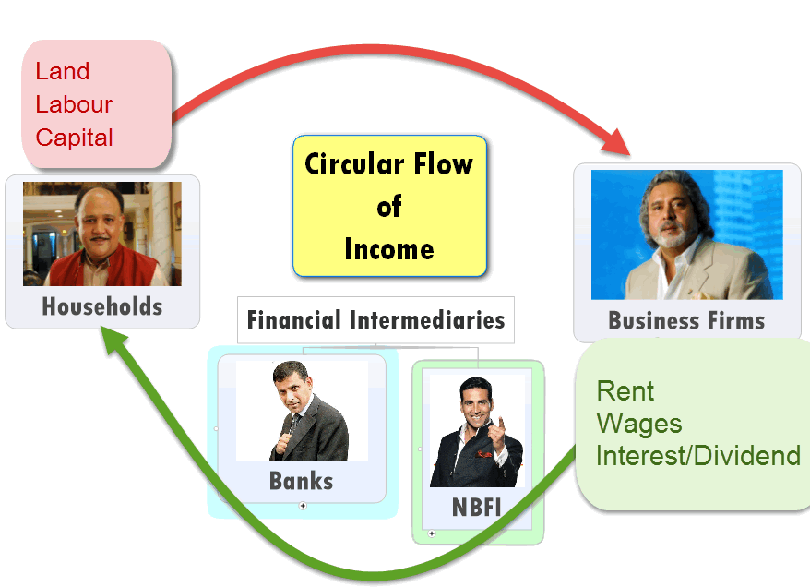

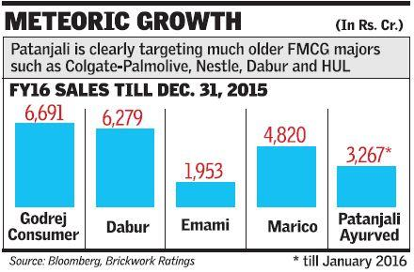
Inefficient firms should shutdown so factors of production can flow towards efficient firms
Chakravyuh Challenge in Economy
1. Political 2. Fiscal 3. Economic cost

Slide 4
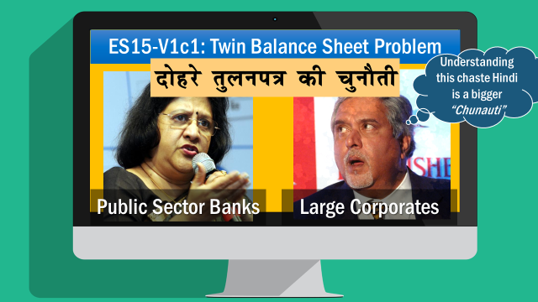
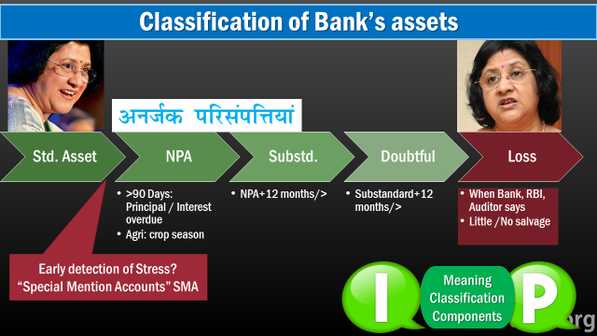
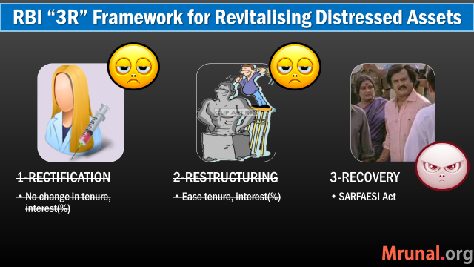
So far we learned

Slide 5
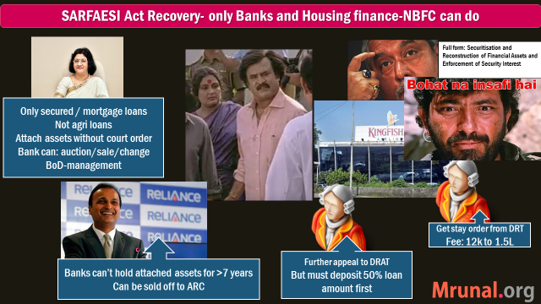
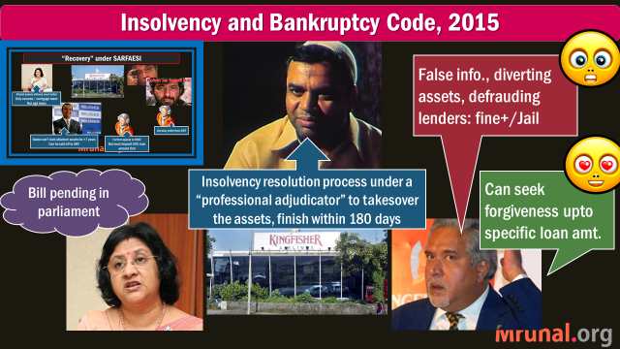
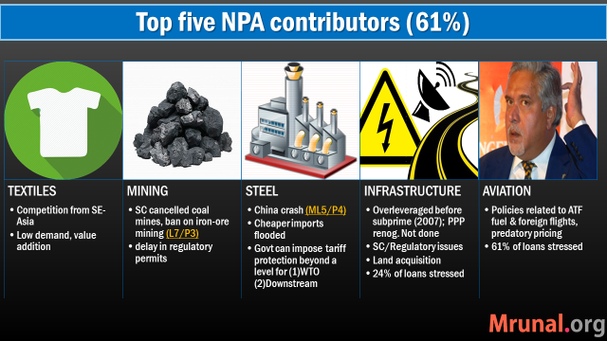
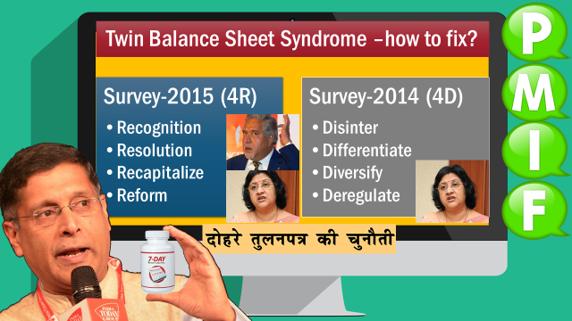
So far we learned…

Slide 6

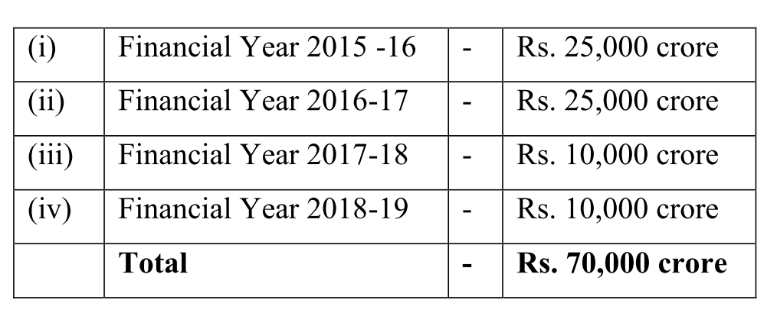
BASEL-III Recapitalization of PSB by 2019, 31st March
Govt: 70kCr (IndraDhanush)
+ Capital Market __?
1.8 Lcr. needed
PSB have 9+ ___
10.8 needed
By purchasing preferential shares; In phased manner, first priority to large & good performing PSBs
Capital: ___?
9% CRAR for BASEL-III
RWA: 120 LCr
Notes:
7th PC : First two years salary? Some say equity with 5.1% return minus 0.1% as Administrative charge?

Slide 7
Recapitalization: addl. 1.8 lakh cr. by 31/03/2019
Equity (Owners/ Proprietors)
Bonds/Debentures/Loan
Must pay interest, principal irrespective of profit / loss
Partnership, IPO-Shares, VCF, Angel Investor
Dividend if profit
Last claim during liquidation
First claim during liquidation
Debt (Creditors)
Addl. Capital 1.8 lakh cr.
Govt employees’ 7th PC award- 50% of increased salary be given in form of bonds “Capitalization Bonds”; optional for pensioners & lower staff
70kcr Preferential shares to govt. (Indradhanush)
1.10 Lakh cr. remains
PSB can issue FPO, but govt. shareholding must remain >50% (Except IDBI)
Notes:
Get firm commitment from client for SMA=>Regular Account
Get addl. investors if possible
Give addl. Loan if required but must not ‘ever-green’
No changes in tenure/interest rate

Slide 8
Banking Sector Reforms: Narsimhan-III, Indradhanush
NPA: 4R4D
BIC
BBB
Bank consolidation
Misc.
Bifurcation of CMD Post

Slide 9

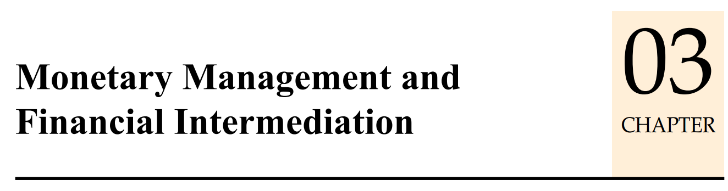

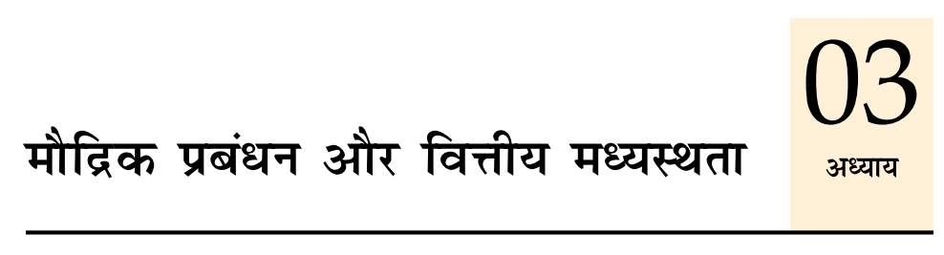



Today’s Session: Banking
NPA, TBS, BASEL, 4R, Indradhanush, BBB
MP Incomplete Transmission, MCLR etc.
Differential Banks
PSL-framework, Certi.
Watch L1/P2 to P9
before going further

Slide 10

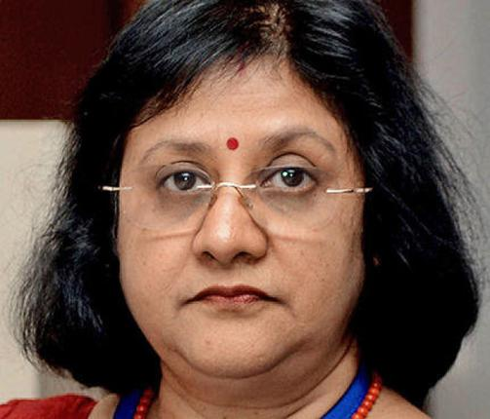






Start/Expand Biz
36% interest on each loan
Onion
Rs.100/kg Rs.2000/kg
Edu.Loan
Input4
Next crop
DDSLLY

Slide 11

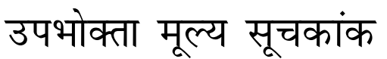
Monetary Policy: Dual Objectives
Price Stability (control both inflation & deflation)
CPI (Combined) 2-6% range
Growth
Agri-Mfg-services, start-ups; Export, Infra,..Inclusive growth: PSL
This is just Recap
Watch L1/P2 to P9 for more

Slide 12
Find correct statement
UPSC Prelim 2015
Controlling the inflation in India is the responsibility of the Govt. only. [absolute term]
The Reserve Bank of India has no role in controlling the inflation [then M.Policy for Timepass?]
Increased money circulation helps in controlling the inflation [DDSLLY / RGSLLY=Onion 2000/kg]
Decreased money circulation helps in controlling the inflation

Slide 13
Monetary Policy: Tools
Quantitative/Gen./Indirect
Qualitative: Selective, Direct
Reserve Ratios (CRR, SLR)
Margin / LTV
OMO: Open market operations
Rates: Bank, MSF, LAF [Repo, RR]
Consumer Credit control / EMI
Credit Rationing /PSL
Moral Suasion
Direct Action
This is just Recap
Watch L1/P2 to P9 for more

Slide 14
UPSC Prelim 2015
36. With reference to Indian economy, consider the following
1. Bank rate
2. Open market operations
3. Public debt
4. Public revenue
Which of them are monetary policy components?
(a) 1 only (b) 2, 3 and 4 (c) 1 and 2 (d) 1, 3 & 4

Slide 15
Mock question
36. With reference to Indian economy, consider the following
1. Bank rate
2. Open market operations
3. Public debt
4. Public revenue
Which of them are qualitative / indirect / selective tools of monetary policy?
(a) 1 only (b) 2, 3 and 4 (c) 1 and 2 (d) None

Slide 16

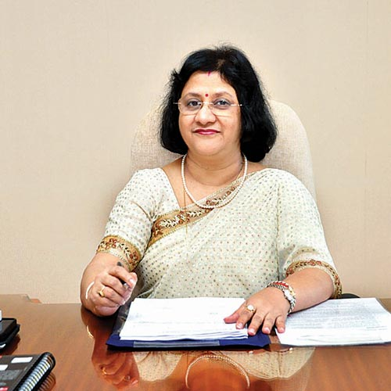

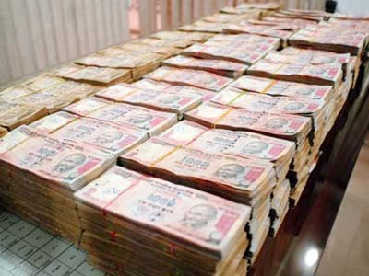
Repo Rate: Meaning?
Repo Rate 8%
100 crore
SBI to Repurchase
@108 Cr.
After 7 days
Collateral: G-Sec
But not from SLR
All clients eligible
Reverse Repo rate: when RBI “borrows” from clients
RR= Repo -1% -0.5% (WEF Apr.2016)

Slide 17
Marginal Standing Facility: Meaning?
MSF: 9%
100 crore
SBI to Repurchase
@109 Cr.
After 7 days
Collateral: G-Sec
Even from SLR
Only SCB eligible
Reverse Repo rate: when RBI “borrows” from clients
MSF= Repo +1% +0.5% (WEF Apr.2016)

Slide 18



Bank Rate: Meaning?
Long term Loan
Interest rate: 9%
BANK RATE
If CRR/SLR not maintained
penalty-: bank rate+3 or 5%
Depending on repeat offense
Collateral: Nothing

Slide 19
Repo rate = Policy rate or Benchmark Rate
Before Apr’16
Repo = 6.75%
After 2016, April Review
RR =Repo-1%
MSF: Repo+1%
Bank Rate = MSF
LAF
Repo cut by 25 basis points
Bank Rate = MSF
Policy rate corridor ▼ 0.5%
Policy rate corridor ▼ 0.5%
See L1 Video series for more LAF vs MSF difference

Slide 20
Repo rate = Policy rate or Benchmark Rate
Before
Repo = 6.75%
After 2016, April Review
RR =Repo-1%
MSF: Repo+1%
MSF: Repo+0.5% =7%
Repo = 6.50%
RR =Repo-0.5% =6%
Bank Rate = MSF
LAF
Repo cut by 25 basis points
Bank Rate = MSF
Policy rate corridor ▼ 0.5%
Policy rate corridor ▼ 0.5%
Even on Sundays, sold @Mumbai
See L1 Video series for more LAF vs MSF difference
Even on Sundays, sold @Mumbai

Slide 21
Monetary Policy to control money supply
Quant. Tool | Inflation fight Dear Money policy | Deflation fight Cheap Money policy
CRR, SLR | Increase | Decrease
OMO | Sell G-Sec | Buy
Repo Rate Policy Rate MSF Bank Rate | Increase | Decrease
This is just Recap
Watch L1 for more

Slide 22
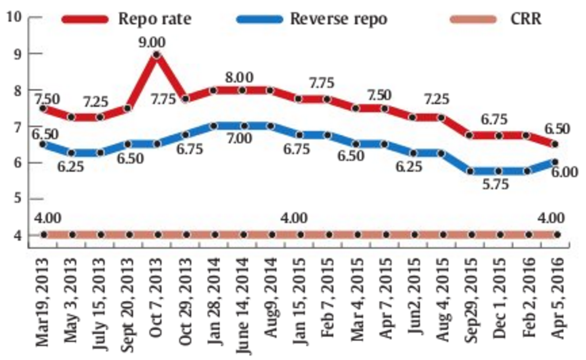
Being Raised to fight inflation
Being reduced to boost growth & fight deflation
Before Rajan
45 days review
Rajan starts 60days
(bi monthly from 2014)
All points not plotted here
Notes:
Modi became PM on 26 May 2014.

Slide 23
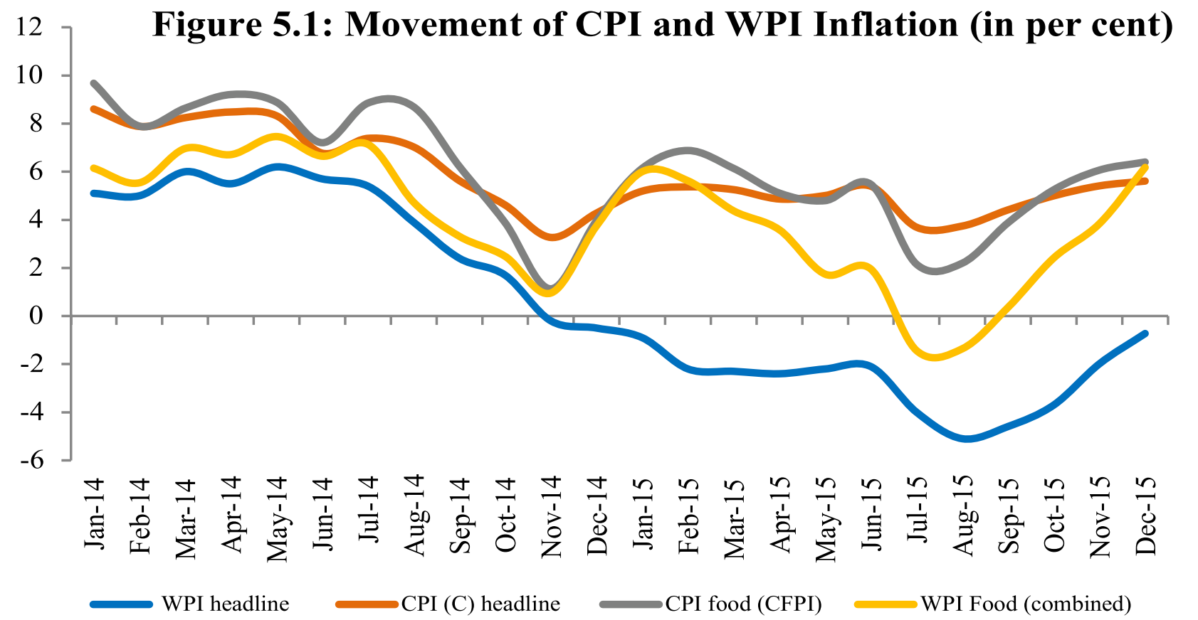
Inflation index theory
L5/P7

Slide 24

Timeline: Monetary Policy Reforms
2014: Urjit Patel Committee Report-More @L1/P4
2015, Feb: MP Framework between RBI-Gov
2016, Feb: Budget promises to amend RBI Act for M.Policy reforms

Slide 25
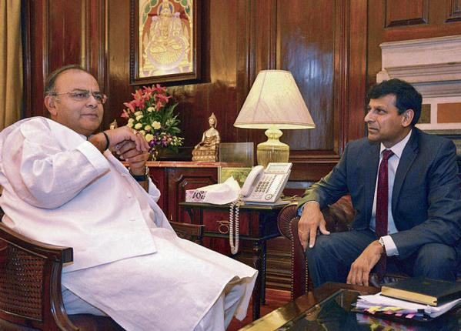

Present Monetary policy framework (on Feb 2015 Agreement)
Flexible inflation targeting (FIT)
Policy rate=Repo rate (RBI Act’34)
CPI-Combined (MOSPI)
2-6% (OR 4 +/- 2% band)
6 monthly .docx on inflation projections for next 6-18 months
Explain to Govt
Why failed (reasons)?
Remedial action with Est.deadline?
RBI Governor to make
Dy.Gov in his absence
#EPICFAIL
CPI-C: outside 2-6%
For 3 quarters cont. (9 months)
Cut-off se bs 2 point kum the ☹
Next year prelim clear ho jaayegaa
Even though vacancies are less.
Promise? Warnaa bike nahi milegi
Notes:
framework
Maintain price stability + growth
Target: CPI-Combined Monthly (by MoSPI) between 2-6% (= 4 ± 2% Band )
Policy Rate = Repo rate under RBI Act 1934 (Sect-17-12AB)

Slide 26
Monetary Policy
Will Amend RBI Act to give statutory status to
Monetary policy framework (2-6%)
Monetary policy Committee (3RBI+3GoI)
Budget 2016

Slide 27
Monetary Policy: Tools
Quantitative/Gen./Indirect
Qualitative: Selective, Direct
Reserve Ratios (CRR, SLR)
Margin / LTV
OMO: Open market operations
Rates: Bank, MSF, LAF [Repo, RR]
Consumer Credit control / EMI
Credit Rationing /PSL
Moral Suasion
Direct Action
This is just Recap
Watch L1/P2 to P9 for more

Slide 28
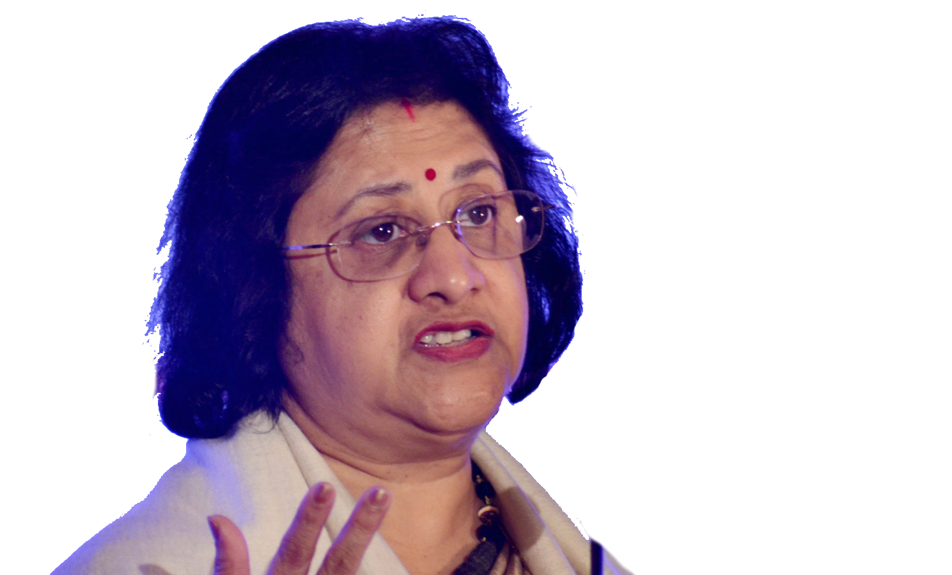

Incomplete transmission of monetary Policy
-43bps
Why r u not ▼ as much as I'm?
-125bps
High SLR,
Double Financial repression
Deposit & credit growth ▼
And many more reasons….

Slide 29
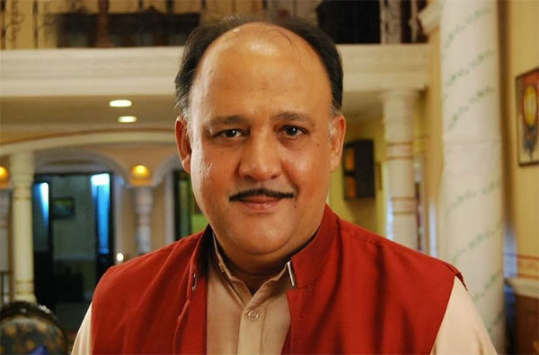
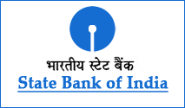

From Bank’s Point of view
Liabilities
Assets
Demand Deposit
Loans
Time Deposit
NDTL
CRR
SLR
40% PSL
Notes:
Bad loans = non-performing assets

Slide 30

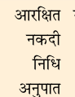


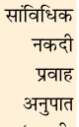
As per Latest M.Policy (2016,Apr)
Time: FDRD
NDTL (100 Crore)
Demand: CASADD
CRR
4%
SLR
22%
21.5%
21.25%
▼SLR =▲ Rs. To lend
Cash, Gold
RBI approved securities (G-sec,T-bill) but not oil bonds, Ferti bonds etc.
Can’t lend
No profit

Slide 31
UPSC Prelim-2015
When RBI reduces the Statutory Liquidity Ratio by 50 basis points, what will happen?
India's GDP growth rate increases drastically
FII may bring more capital into our country
It may drastically reduce the liquidity to the banking system
Scheduled Commercial Banks (SCB) may cut their lending rates
If “MUST” used then this statement will also be wrong.

Slide 32
Mock question for Prelims
Survey-14; V1c5
Assertion (A): Under SLR norms, RBI requires banks to hold a certain share of their resources in liquid assets such as cash, government bonds and gold.
Reason (R): SLR performs a prudential role during unexpected demand from depositors by quickly liquidating these assets.
Both right, R explains A

Slide 33
How exactly is CRR,SLR computed? Fortnight lag
Fortnight
Fortnight
Friday
NDTL
100 Cr.
Friday
Friday
Rs.21.25 cr. SLR
Rs.4 cr. CRR
Daily maintain 95% 90% [M.policy: Apr’16]
Short term borrowing among Bank-FI (mainly) to fullfil CRR
Call Money- 1 day
Notice Money- >1 upto 14 days
If CRR/SLR not maintained penalty-: bank rate+3 or 5%
Depending on repeat offense

Slide 34

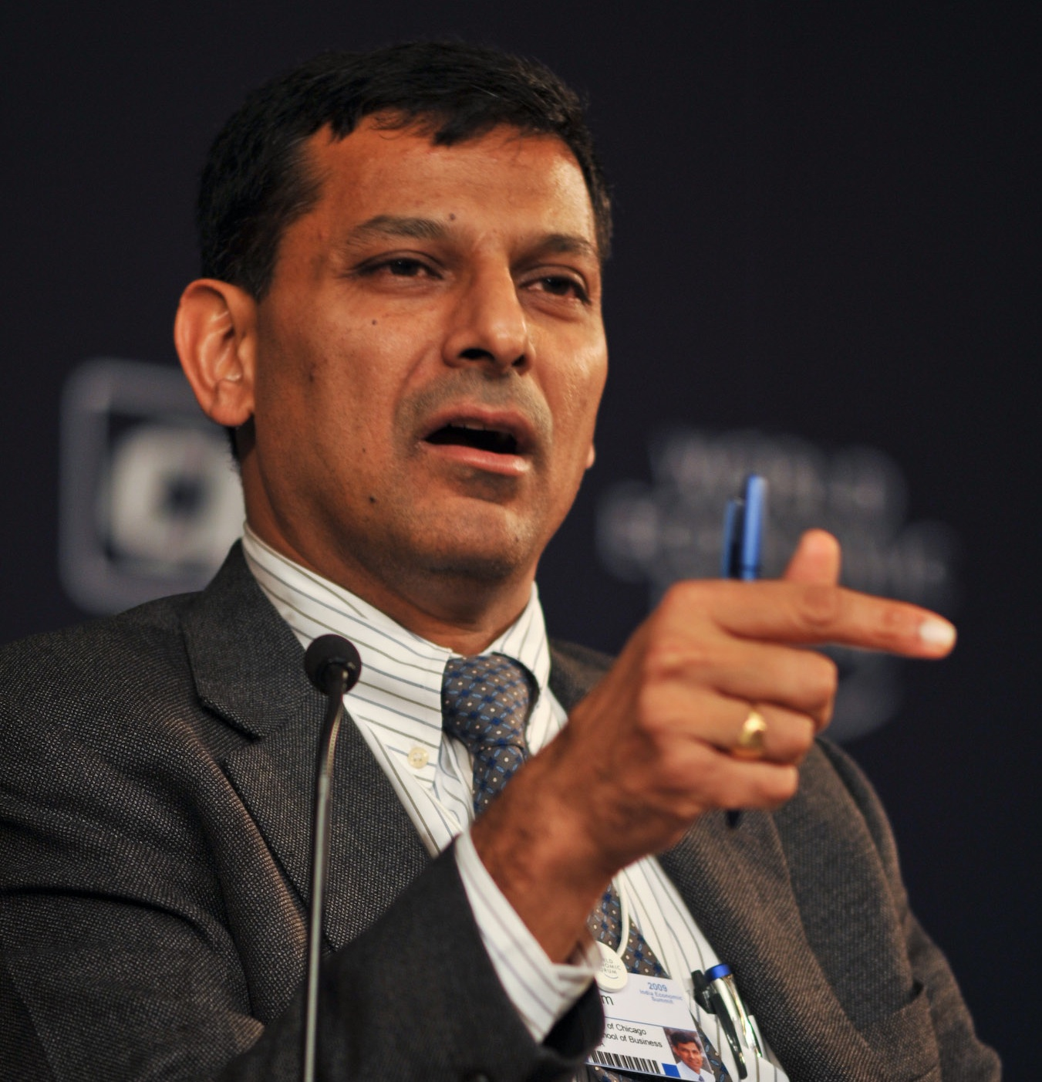
Financial repression of PSB #1 (Asset side)
Government ☺
Borrowers ☹
Still PSBs keeping >25% of their NDTL in G-Sec
Recommends SLR ▼
Kyoki Hum bi desh ke liye khelte hai
#Bharat-ratna4Narsimhan
Notes:
In practice, the SLR has become a means of financing (at less than market rates presumably) a bulk of the government’s fiscal deficit, suggesting that SLR cuts are related to the government’s fiscal position
+nt: infra / PPP finance: private sector doing External commercial borrowing (ECB)
But if $$ gets stronger than Rs.=> Company’s profitability & balance sheet in trouble.
SO, if SLR lowered: local banks could lend more of customers’ money to such infra/PPP projects.

Slide 35
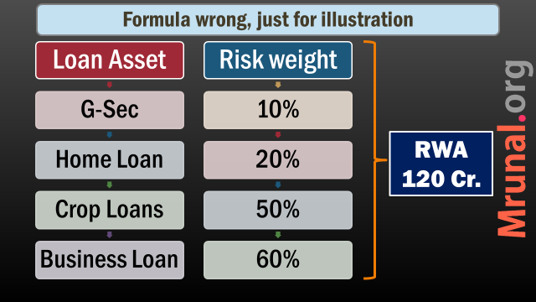

What if banks put more Rs. Here?
Instead of loaning?
RWA 100Cr.
A&R / C&C
In other words
High level of stressed assets encourage PSB to overinvestment in risk free G-sec to maintain a respectable risk-weighted capital adequacy ratio to comply with BASEL-III
Capital 9 cr.
Capital 10.8 cr.
9% CRAR
RWA 120 Cr.
RWA 100Cr.

Slide 36
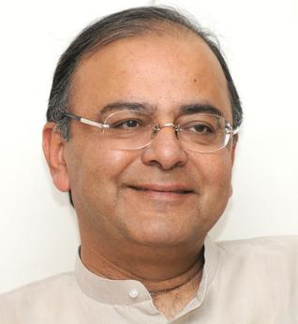
Financial repression of households
A&R / C&C
Depositor (4-7%)
Bank (Margin)
G-sec (8%)
Exits towards
Gold (CAD ▲: weaker Rs.=Expensive petrol/diesel)
Real estate (Speculation, Black $$)
Solutions
RBI : “Ceiling”?
Govt.: PDMA
Independent BIC
Govt gets cheap credit,
Private sector is deprived
▼Biz.Expansion, job, GDP

Slide 37
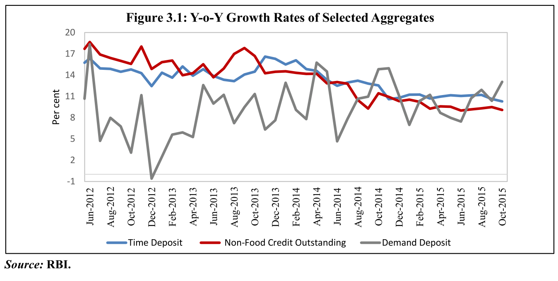
Deposit and credit growth ▼

Slide 38


Deposit Interest rates and purchasing power
1st Jan
Rs.100
Onion 20 per kg
31st Dec.
Rs.104 (SA -Demand) Rs. 108 (FD-Time)
Onion 22 per kg
Can buy 4.55 kg Can buy 4.91 kg
Can buy 5 kg
Money ▲
PP ▼

Slide 39
SBI: 5 year term-deposit
Year
2012
Nominal Interest
9.25
Minus Inflation
-11%
Real Interest Rate
-1.75
Purchasing Power ▼
Client shd buy gold, real estate

Slide 40
SBI: 5 year term-deposit
Year
2012
2015
Nominal Interest
9.25
Minus Inflation
-11%
-5.4%
Real Interest Rate
-1.75
7.00
+1.6
Purchasing Power ▼
Client shd buy gold, real estate
Purchasing Power ▲
Client should move towards
“Time deposits” (FD/RD)
But why reduced? Explanation upcoming

Slide 41
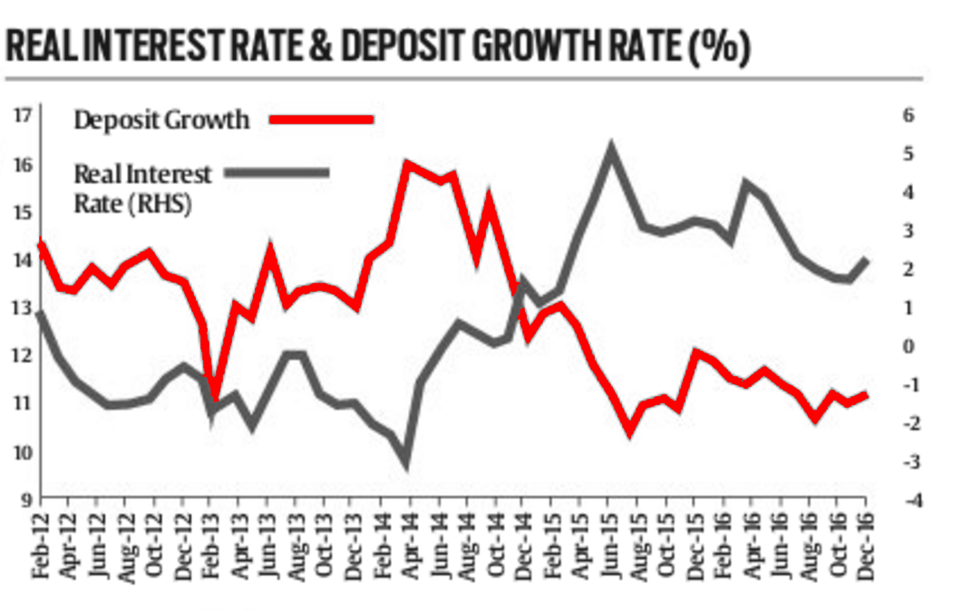
Like this…

Slide 42
But it’s no longer happening, says Survey & SBI
Following the conventional theory
Not following

Slide 43
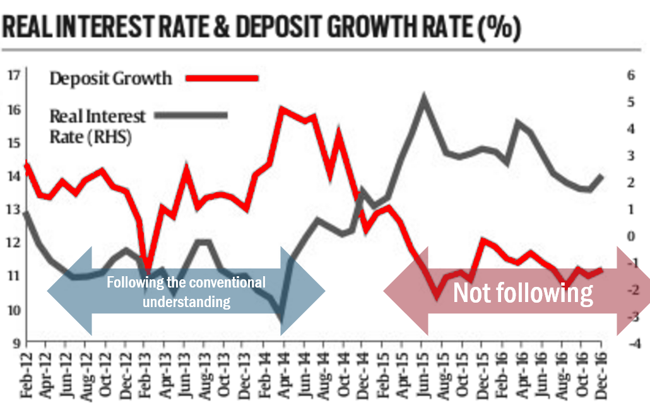
High RIR can have either of the two effects on Deposits
Substitution Effect
Save now, consume later.
But may be diverted to PPF, KVP offering Higher % than FD?
Wealth Effect
Spend now, save later. (Nominal Interest Rate is low); GDP growth is consumption led (Survey)
~Election time, Public holds more Cash (Rajan)
Outward remittances abroad, >4 Bn$ gone since 2014; Sending to study abroad, close relatives, trip (SBI)
Still tied to Gold, Real Estate (Survey)
A&R / C&C
2TF/3TF
Notes:
The real rate of interest on deposits turned positive in late 2013 after inflation dropped to below 9 per cent but time deposits have not picked up, partly because households savings are channelized to other avenues like gold and real estate.
When inflation dips, depositors ought to put $$ in term deposits to get positive real interest rate.
But 10% decline in deposit growth- lowest in 53 years.
Currency with public: Rs.13.86 lakh=> 15.93 lakh in a year. SBI and others baffled how?

Slide 44
LRS- each year 3 lakh students going abroad. >1 billion
LRS-2004
Indian resident can spend $2.5 lakh per year abroad
For both current & capital account transactions. (BoP Lecture series)
RBI kept relaxing
2013: 75k
2014: 1.25L
2015: 2.5L

Slide 45



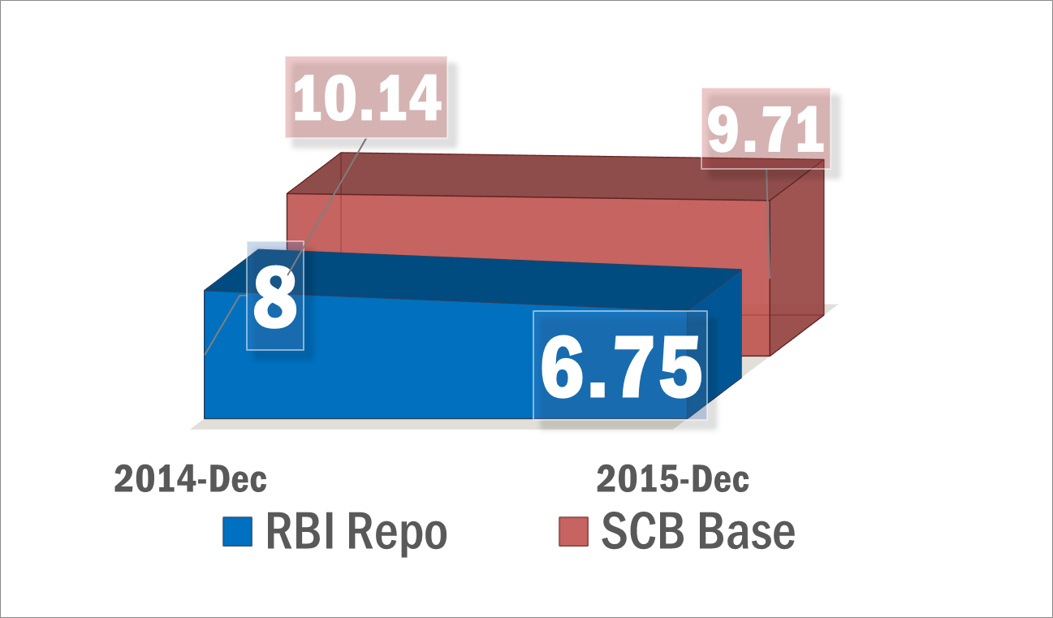
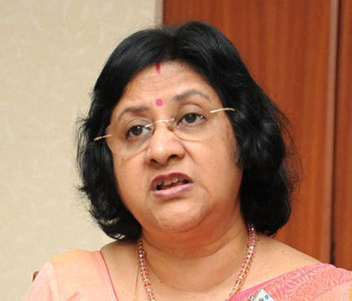
Negative spillover
Bogus Higher edu. In India
Juntaa going abroad with $1 bn
Banks deposit esp. Time deposits
Loan rates not ▼
PSL, housing, Entrepreneurs, suffer

Slide 46

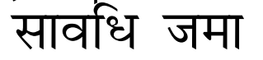

CRR, SLR counted on NDTL
Demand Liabilities
Time liabilities
Current Account (CA)-0%
Savings Account (SA)-4%
Demand Draft
~11,800 Billion Rs.
Fixed deposits (FD)-~7%
Recurring deposits (RD)
Cash certificates
Staff security deposits
~92,000 Billon Rs.
Meaning
Classification
Components
More reliable “raw” material for Banks
++ NDTL =Banks rely less on RBI for money= incomplete Transmission of MP
Notes:
On 1april 2016

Slide 47
Impact of Time deposit on Credit lending
Demand deposits= unreliable source to run a Bank loan biz.
As Time deposit ▼
Loaning ▼ = bad for economy

Slide 48
Assertion- Reasoning
Economic Survey
A) Slowdown in time deposits, will hamper the growth in bank credit.
R) Time deposits are cheaper source of funding, and allow banks to afford higher interest rate spreads.
Both correct and “R” explains “A”
(Ref: ES-15-V2c3 Page 50)

Slide 49
Bank Deposit growth ▼
Despite ▲ Real Interest Rate
We’ll give less loans; invest more in G-Sec
BASEL-III looming
Wealth effect is high… financial repression…not good for economy

Slide 50
Double Financial Repression on “Banks” (ES-14)
Assets
NPA ▲
PSL- esp. Agri
Liability
Equity ▼
SLR (low return)
Deposits ▼

Slide 51


Q3-2015: Financial statements of PSBs (Rs.Crore)
#EPICFAIL in History of Indian Banking Industry
62%▼
93% less profit then earlier year’s same quarter (Oct-Dec)

Slide 52
Find Correct Statement?
From Survey
Twin balance sheet problem is associated with financial stress in Government owned Banks and PSUs.
“Double Financial repression” means inability of households to gain positive returns from banks and share market.
Twin Deficit means high level of fiscal deficit and Revenue deficit.
None Correct.

Slide 53
Find Correct Statement?
From Survey
Twin balance sheet problem is associated with financial stress in Government owned Banks and PSUs Large corporates
“Double Financial repression” means inability of households to gain positive returns from banks and share market. Banks’ problems on asset & liability side
Twin Deficit means high level of fiscal deficit and Revenue deficit CAD
None Correct.

Slide 54
Incomplete transmission of monetary Policy
-43bps=
MP.Framework reformed
Inflation controlled
Why r u not ▼ as much as I'm?
-125bps=
SLR & Double Financial repression
Deposit growth ▼
Credit demand & growth ▼

Slide 55
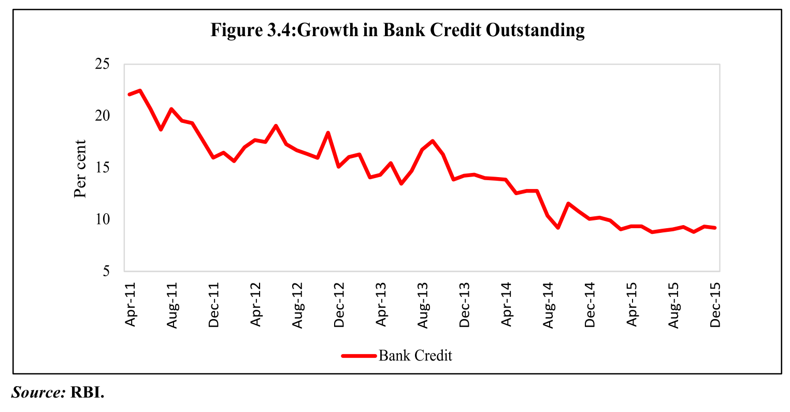
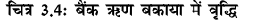


Bank credit growth declining/sluggish in recent times
Earlier 20% YoY growth (2003-08)
In abs qty- PSL will also suffer; inclusive growth ☹

Slide 56

Incomplete transmission of Monetary Policy
Why r u not ▼ as much as I'm?
-43bps=
-125bps=
Many reasons ☹
PSL too cud have got cheaper loans otherwise ☹
Buy home / Car- postponed ☹

Slide 57
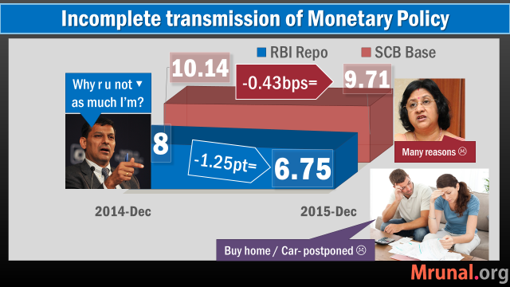
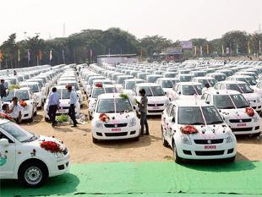
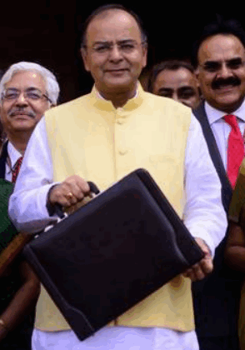

Negative spillovers
Negative growth in automobile sector
2014-15: govt. ▼ Excise Duty on cars to ▲ demand
But Fiscal capacity ▼ => less $ for HRD/infra
Syllabus GSM-II:
Government policies and interventions for development in various sectors and issues arising out of their design and implementation.
+Role of Pressure groups in Polity
Cheap Chinese Steel imports
Indian steel makers oppose
Indian Automakers = ☺

Slide 58
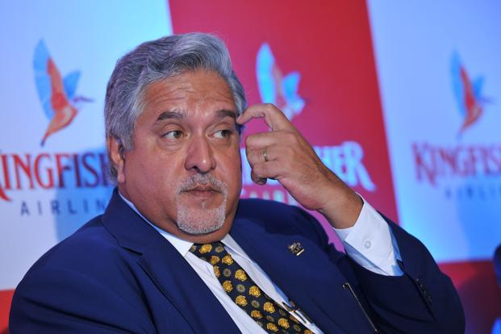

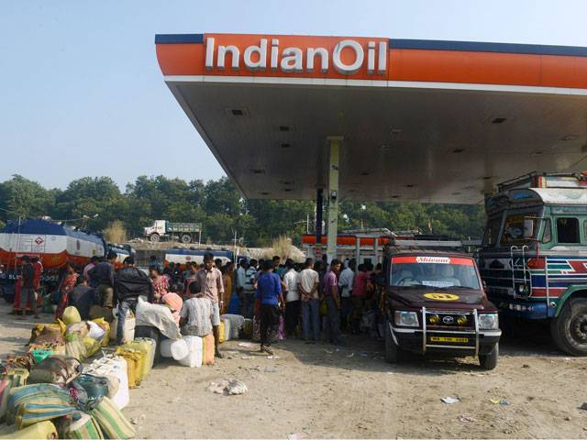
Why bank credit growth ▼?
Postpone car/home loans
High loan interest rate/
Twin Balance sheet/
Expansion plans halted/
Banks reluctant
Indian cos going for
Bond Market (attractive rates)
ECB (RBI relaxed)
OMC borrowing less from SCB

Slide 59
Why OMC borrowing less from SCB?
Before
Administered Prices
OMCs had borrow from Banks for working capital in between
Govt. paid difference to OMC in “Bonds” with 5/> yrs maturity
After deregulation of Petrol-Diesel (Kirit Parekh)
Market determined prices
OMCs have good cash flow=> lower requirement of bank credit
Notes:
Incomplete transmission of the monetary policy: Banks not ▼ loan Rates as fast as RBI ▼ Repo.
Due to Twin Balance sheet problem
Banks unwilling to Lend (NPA, CRAR)
Corporates’ expansion plans delayed
ECB norms relaxed; attractive to borrow from Bond market
OMC borrowing ▼ after petro-diesel deregulation

Slide 60
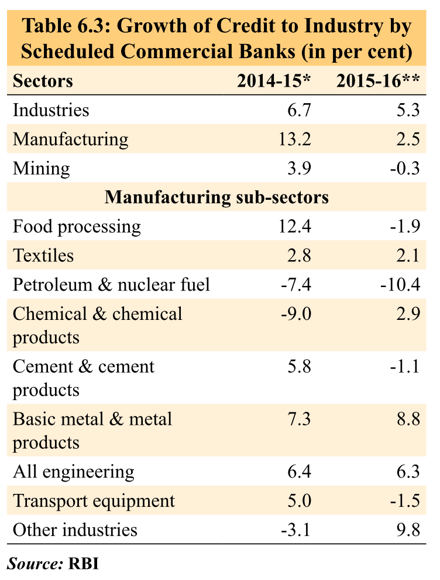
V2c6: industrial & corporate sector
Though mining bill, coal auction but yet to recover
Two successive drought years
OMCs need less credit after deregulation of petrol/diesel
Infra. regulatory overhaul,PPP revamp, smart cities but yet to pickup
Incomplete transmission =Delaying car purchase

Slide 61
Economic Survey 2015
Latest Eco. Survey has observed sluggish growth in Bank credit in recent years. What factors are responsible?
Incomplete transmission of monetary policy
Increased attractiveness of Bond Market
Rationalization of fuel subsidies
Choices:
A): Only 1 and 2; B): Only 2 and 3;
C): Only 1 and 3; D): All of them
Notes:
V2 pt.6.26

Slide 62

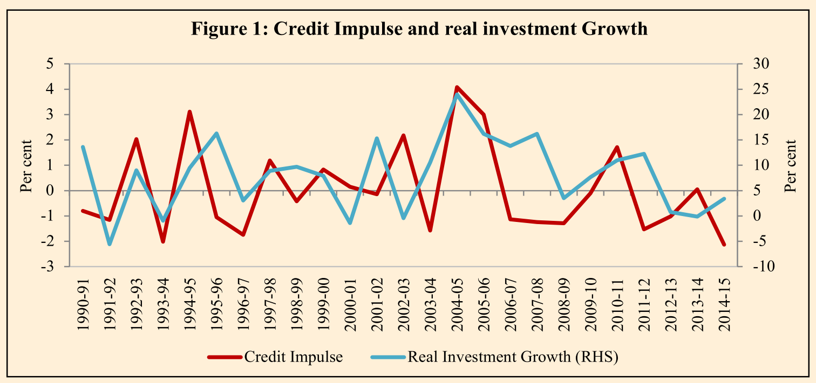

Credit impulse
Survey-2015
Deutsche Bank economist Michael Biggs (2008)
Credit impulse= % (change in new credit issued / GDP)
▲ Credit impulse = ▲ investment
Meaning

Slide 63
Incomplete transmission of monetary Policy
-43bps=
Why r u not ▼ as much as I'm?
-125bps=
Double Financial repression
Deposit growth ▼
Credit demand & growth ▼
Post Office, KVP, NSC….
So much to criticize, yet theHindu not focusing. Curious :P

Slide 64

Small savings schemes hinder transmission of monetary policy
To fight deflation / boost growth
I’ll cut repo rate =cheaper funds=cheaper loans
Post: FD: 8.40%
KVP: 8.7%
Deposit
1 yr FD
7.30%
Lending
Base rate
9.30%
Margin
9.30-7.30= 2%
Deposit
1 yr FD
6.30%
If banks are expected to decrease lending rate, they’ll want to deposit rate as well to keep margin same…
Lending
Base rate
8.30%
But Banks can’t, because competition here….juntaa will switch here
Notes:
Because small savings schemes offer high and fixed deposit rates (within year) and compete with banks, it is difficult for banks to reduce their own deposit rates and hence pass on policy rate cuts to consumers in form of lower lending rates.
Recently, the government has reduced rates on some small savings schemes to make them more responsive to market
conditions.
Parallel: For the April-June Quarter of 2016, government has reduced the interest rates on PPF, KVP and small savings schemes by up to 1.3%. (April 2016)

Slide 65
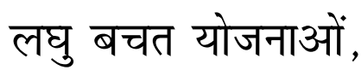
Assertion and reasoning
From survey
(A) Small saving schemes have hindered the transmission of monetary policy in recent years.
(R) the return on small savings schemes has been higher than Bank deposits
Ans. Both right, “R” explains “A”.

Slide 66
Government reduced interests in 2016
Eventhough Central board of trustees said 8.8 & unions threatened action…
If I fail Monetary policy targets for 3 quarters, my “justification.docx” will also blame you & your post office.
1 teer kayi shikaar
Faster transmission of monetary policy
Fiscal deficit also controlled
Real interest rate still positive
Not enough balance in EPF
++ we’ll keep updating rates each quarter (3 months) = better synergy with your bi-monthly M.P.Review
Shaabash…khub milegaa rang jb mil bathenge 2 yaar
Notes:
Cut in the same savings rates
WEF 1/4/2016
Scheme
Before
After reduction
PPF
8.7
8.1
KVP
8.7
7.8
Sukanya Samridhi
9.2
8.6
Senior citizen small savings
9.3
8.6
NSC
8.5
8.1
Post office term deposit,RD
8.4
7.4

Slide 67
In February 2016
Past Observations (Vol2)
Future Suggestions (Vol1)
High returns in Small Savings =incomplete transmission of monetary policy.
So, govt ▼
Past Data
Future Plan
1st April 2016
Tax collection & Expenditure
31st March 2017

Slide 68
Incomplete transmission of monetary Policy
To boost economy, I’ve been cutting Repo rate since last year..
Now even I’ve cut down interest rates on various small savings, schemes
Still if banks don’t reduce loan rates, what to do?
Ab unko “MCLR” ka dose denaa pdegaa….

Slide 69

Who decides loan interest rates?
Govt. RBI interference
1991: M.Narsimhan- deregulate
2010: Base Rate
Benchmark Prime Lending Rate (BPLR)
2016: MCLR
#Bharatratna4-Narsimhan
Kyoki hum bhi “desh” ke liye khelte hai
a.k.a. Aag, Paani aur Bhai se
Khelne ki sazaa 4SCB

Slide 70
Base rate system: suppose SBI decided Base Rate 10%
SBI’s | +Spread | Base rate+Spread
Car loan | 0.75% | 10.75%
Two wheeler | 8.25% | 18.25%
Education (4L) | 3.5% | 13.5%
Home (upto 75L) | 0.15% | 10.15% (10.10%W)
Home (>75L) | 0.30% | 10.30% (10.25%W)
Notes:
Banks cannot lend below Base rate.

Slide 71
What is the difference?
Base Rate
CRR Cost
Operating Cost
MCLR
Min. rate of return
Deposit Interest (Cost of Funds)
Reviewed on Bank’s discretion
Focused on avg. cost of funding
More Technicals here
Notes:
enor premium
These costs arise from loan commitments with longer tenor. The change in tenor premium should not be borrower specific or loan class specific. In other words, the tenor premium will be uniform for all types of loans for a given residual tenor.

Slide 72
Marginal Cost of Funds based Lending Rate (MCLR)
Base Rate
CRR Cost
Operating Cost
MCLR
CRR Cost (Negative Carry)
Operating Cost
Min. rate of return
Marginal cost of funds:
Repo Rate
Deposit Interest
Deposit Interest (Cost of Funds)
Tenor premium on long term loans
Return on Networth (Cost on equity)
Must be reviewed monthly; fixed loans >3 years exempt
Rate offered on new deposits @review date
Reviewed on Bank’s discretion
Focused on avg. cost of funding
More Technicals here
Notes:
enor premium
These costs arise from loan commitments with longer tenor. The change in tenor premium should not be borrower specific or loan class specific. In other words, the tenor premium will be uniform for all types of loans for a given residual tenor.

Slide 73


SBI Home Loans
Base Rate: 9.3%
Before (2015)
After (WEF 1/4/2016)
MCLR: 9.2%
+ Spread 0.25%
+ Spread 0.25%
=Home Loan@ 9.45%
=Home loan@ 9.55%
Haa toh repay kr do naa!!
Rs.1,000 saved in 10 lakh loan….
Only after you re-tweet #bharatranta4Mallya because mein bhi desh ke liye kheltaa hu.
Notes:
1000 rs. Lesson 10 lakh loan
Women- its 20bps
Marginal Cost of Funds based Lending Rate (MCLR)
Exempt: Loans >3 year tenure
Existing customers can shift to this system with caveats.
SBI's new MCRL rate: 9.2% for 1 year, 9.3% for two year, 9.35% for three years.

Slide 74
Full pass through of monetary policy not happening because
ES-2015 v2c3 Monetary Management
Competition from small saving schemes where interest is higher and not revised frequently.
Savings deposit rates of PSBs unchanged @4% despite de-regulation.
Base rate of banks determined on basis of avg. cost rather than marginal cost.
Choices:
A): Only 1 and 2; B): Only 2 and 3;
C): Only 1 and 3; D): All of them

Slide 75
Full pass through of monetary policy not happening because
ES-2015 v2c3 Monetary Management
Competition from small saving schemes where interest is higher and not revised frequently.
Savings deposit rates of PSBs unchanged @4% despite de-regulation.
Base rate of banks determined on basis of avg. cost rather than marginal cost.
Choices:
A): Only 1 and 2; B): Only 2 and 3;
C): Only 1 and 3; D): All of them (page.56)

Slide 76


structural rigidities=> incomplete transmission of monetary policy:
Limitations
Base rate of banks were determined on the average cost rather than marginal cost: RBI Fixed by MCLR
Small savings schemes offering higher interest rates (Govt. Fixed)
Junta moved towards gold, real estate, even after inflation decline + LRS=> deposit growth ▼
Corporate credit demand ▼; not “enough volume” to decrease loan interest rate.
A&R /C&C

Slide 77
M.Policy can’t alone combat inflation/low-growth
Limitations
Incomplete transmission (prev.slide)
Monsoon uncertainty, cyclone, flood, draughts => Supply side constrains
Crude oil, gold import
Unorganized money market; Shroff; lack of financial inclusion; Black money, underground economy
Fiscal deficit, subsidy leakage
7th PC; OROP : won’t hurt *that* much on inflation front says survey
A&R /C&C

Slide 78
Incomplete transmission of monetary Policy
-43bps=
Why r u not ▼ as much I’m?
-125bps=
Double Financial repression
Deposit growth ▼
Credit demand & growth ▼
Post Office, KVP, NSC,
Base Rate

Slide 79
Monetary Policy: Tools
Quantitative/Gen./Indirect
Qualitative: Selective,Direct
Reserve Ratios (CRR, SLR)
Margin / LTV
OMO: Open market operations (See L1/P2)
Rates: Bank, MSF, LAF [Repo, RR]
Consumer Credit control / EMI
Credit Rationing /PSL
Moral Suasion
Direct Action
This is just Recap
Watch L1/P2 to P9 for more

Slide 80

Today’s Session: Banking
NPA, TBS, BASEL, 4R, Indradhanush, BBB
MP Incomplete Transmission, MCLR etc.
Differential Banks
PSL-framework, Certi.
Watch L1/P2 to P9
before going further

Slide 81
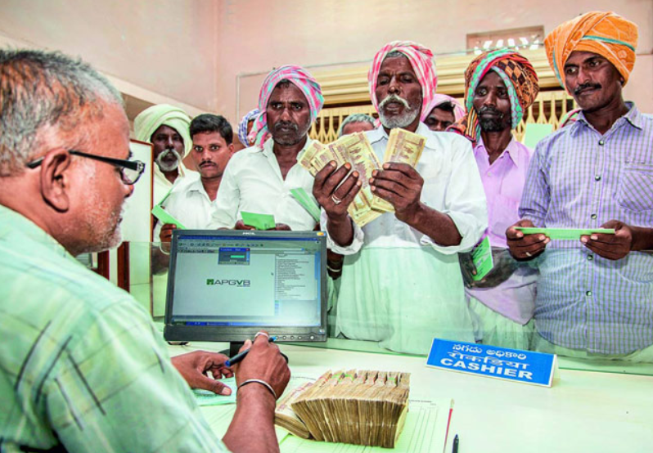

Priority Sector Lending (PSL)
Inke liye kuchh nayaa karnaa pdegaa

Slide 82
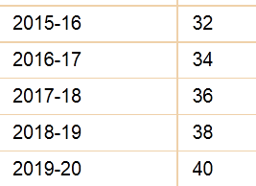
April 2015: PSL norms revised
Deposit & credit growth ▼
Then PSL qty= ▼
Inclusive growth= ▼
SCB | Foreign Banks 20/> branches
40% | (RRB: 60%| 75%)
Foreign Banks banks <20 branches
40% But in phased manner
Adjusted net bank credit OR
Off balance sheet exposure
Whichever is high
SCB = domestic scheduled commercial banks
Notes:
Reserve Bank of India (RBI) on Thursday revised the priority sector lending target for regional rural banks (RRBs) to 75% of total outstanding loans from 60% earlier, effective January 2016.
The central bank said that data on priority sector advances has to be furnished by RRBs to Nabard at quarterly and annual intervals. “For the purpose of calculation of priority sector lending targets, total outstanding will be calculated as on corresponding date of the previous year,” it added.

Slide 83


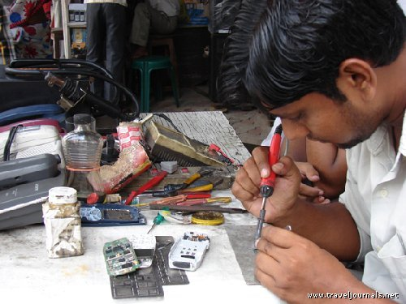
New PSL:WEF 1/4/15; *=new cat.; Loan given to MFI also counts
Category | % SCB
Weaker Sections | 10%
Agri | 10%
*Marginal Farmer (upto 1ht) *Small farmer (>1 upto 2ht) | 8%
Micro Enterprises Khadi-Village indu. | 7.50%
All PSL categories | 4.5%
Total PSL | 40%
Notes:
After reviewing in 2017 they’ll do post-2018
Total Priority Sector Target within a maximum period of five years starting from April 1, 2013 and ending on March 31, 2018 as per the action plans submitted by them and approved by RBI.

Slide 84
New PSL:WEF 1/4/15; *=new cat.; Loan given to MFI also counts
Category | % SCB | FB with 20/>+
Weaker Sections | 10% | Mar. 2018
Agri | 10% | Mar. 2018
*Marginal Farmer (upto 1ht) *Small farmer (>1 upto 2ht) | 8% | Post-2018
Micro Enterprises Khadi-Village indu. | 7.50% | Post-2018
All PSL categories | 4.5% | --
Total PSL | 40% | Mar.2018
Notes:
After reviewing in 2017 they’ll do post-2018
Total Priority Sector Target within a maximum period of five years starting from April 1, 2013 and ending on March 31, 2018 as per the action plans submitted by them and approved by RBI.

Slide 85
New PSL:WEF 1/4/15; *=new cat.; Loan given to MFI also counts
Category | % SCB | FB with 20/>+ | FB <20
Weaker Sections | 10% | Mar. 2018 | NA
Agri | 10% | Mar. 2018 | NA
*Marginal Farmer (upto 1ht) *Small farmer (>1 upto 2ht) | 8% | Post-2018 | NA
Micro Enterprises Khadi-Village indu. | 7.50% | Post-2018 | NA
All PSL categories | 4.5% | -- | Upto 32% in export units upto Rs.100 cr. turnover
Total PSL | 40% | Mar.2018 | 40% by 2020
Notes:
After reviewing in 2017 they’ll do post-2018
Total Priority Sector Target within a maximum period of five years starting from April 1, 2013 and ending on March 31, 2018 as per the action plans submitted by them and approved by RBI.

Slide 86
PSL Definition: Weaker sections
Small, Marginal, Distressed Farmers
Women upto Rs. 1 lakh per borrower
SC, ST, PH and minorities
Artisan, Cottage/Village industry- upto Rs.1L
NRLM/NULM Beneficiaries; Rehabilitee Manual Scavengers
PMJDY overdraft upto Rs.5k : provided household annual income does not exceed ₹ 100,000/- for rural areas and ₹ 1,60,000/- for non-rural areas [Watch L1/P8 for more on JDY]

Slide 87
'Pradhan Mantri Jan-Dhan Yojana' has been launched for
UPSC 2015
(a) providing housing loan to poor people at cheaper interest rates
(b) promoting women's Self-Help Groups in backward areas
(d) providing financial help to the marginalized communities
(c) promoting financial inclusion in the country [& to insult aspirant’s intelligence by asking this MCQ]

Slide 88


You’ve to remain lucky every time, I’ve to remain lucky only once
- Devgan and UPSC

Slide 89
Out of the 4.5 lakh+ aspirants in 2014 & 15
Easy papers don’t mean more selections
CSAT-P2 33% qualifying doesn’t mean = more selection

Slide 90
Back to PSL Definitions of MSMS industry
Mfg. (plant-machine investment)
Micro: upto 25 lakh
Small: >25l-5cr.
Medium:>5-10cr
Service (equipment investment)
Micro: upto 10 lakh
Small: >10l-2cr.
Medium:>2-5cr
Area <10k population
Investment<15k / worker
All eligible, but special quota of 7.5% for Micro enterprises & Khadi-Village industries

Slide 91
PSL: other categories [** new cat.] Technical Details
Agri
Rs.20 lakh out of Rs.25 lakh home in other areas
Rs. 28 lakh out of Rs. 35 lakh home In Metro (10Lakh/>)
Home repairs, slum rehab etc. eligible with similar caveats
Export credit
100 cr. Turnover
Max. 2% for SCB and FB(20/>Branches)
Housing
Apart from farmers/KCC
Soil conservation, watershed
Vermi compost, bioferti/pesti; seed production (but max Rs.100 cr)
Cooperative societies, food processing, PACS, MFI, RIDF (NABAD)
Notes:
Existing: housing / edu. Loans, export credit
New categories Medium enterprises, social infra and renewable energy.
Separate PSL target for small / marginal farmers, micro enterprises.
no distinction in direct / indirect lending to agro.
More details: on individual categories and quantitative limits- visit https://rbi.org.in/Scripts/NotificationUser.aspx?Id=9688&Mode=0

Slide 92
PSL: other categories [** new cat.] Technical Details
** Social Infrastructure (in T2 to T4 centers)
schools, health care facilities,
**Renewable Energy
upto ₹ 15 crore to solar/biomass generators, wind mills, micro-hydel plants; non-conventional energy for street lights, remote village
drinking water facilities and sanitation facilities
upto Rs. 10 lakh for individual household
Education Loans
Upto Rs.10 lakh
Notes:
Existing: housing / edu. Loans, export credit
New categories Medium enterprises, social infra and renewable energy.
Separate PSL target for small / marginal farmers, micro enterprises.
no distinction in direct / indirect lending to agro.
More details: on individual categories and quantitative limits- visit https://rbi.org.in/Scripts/NotificationUser.aspx?Id=9688&Mode=0

Slide 93
Problems and solutions
PSL
18/40 = 45% of PSL goes to Agro
Last decade: Agro-loans qty ▲ but Agro-GDP qty/rate NOT ▲
▲ in large sized loans to individual farmers & Loans concentrated near urban areas.
New PSL solved: 8% for small/marginal
Lending increased in Jan-March period when farmers don’t need it but banks have ‘March rush’ =>
loan money not used for agro but social events, house repairing, vehicle /mobile purchase etc.
New PSL solved: Annual Quarterly reporting
Notes:
The most important amongst them is that 45 per cent of all priority sector lending must be made to agriculture.
To be sure, the social and economic objectives that underlie PSL make it a salient feature of banking in India
But like in the case of subsidies and direct transfers, greater attention must be given to ensuring that the deployed means are the most effective to achieving desired ends.
There is hence greater need for evidence-driven policy.
summarize striking findings on agricultural credit. The main takeaway is that a much more careful approach needs to be applied to defining what constitutes priority sector and closer monitoring of how these funds are disbursed
This is especially important because a 40 per cent requirement absorbs a large fraction of the banks’ resources.
In nominal terms, agricultural credit has grown more than 8 times in the last 15 years compared to the facts that agriculture’s share in GDP has remained almost constant, and that significant urbanisation has occurred in this time.
There has been a sharp increase in the share of large-sized loans in agricultural credit
There has been a substantial increase in share of agricultural credit outstanding that emanates from urban and metropolitan areas, which is deeply puzzling.
There has been a concentration of disbursal of agricultural credit from January to March, which are generally not the normal periods of borrowing by farmers.
This shows that in order to meet priority sector lending targets banks possibly raise their lending activity in months when farmers may not necessarily need it the most.
There is a sharp decrease in the share of long-term credit in total agricultural credit. Thus, the portion of agricultural credit that was used for capital formation in agriculture has become small. The number has come down from over 70 per cent in 1991-92 to about 40 per cent in 2011-12
The implication of this evidence is that lending to agriculture may be excessive and going predominantly to large farmers. It is not being used for agricultural capital formation. Perhaps most significantly a large share of it may not be going to core agricultural activities at all.

Slide 94

PSL: What if targets not met?
Desi (+Foreign 20/>)
Remaining $$ to RIDF
Rural infra. Development fund
NABARD manages
NABARD pays interest to bank
State governments get infra. Loan

Slide 95
PSL: What if targets not met?
Desi (+Foreign 20/>) | Foreign bank <20
Remaining $$ to RIDF | To SEDF
Rural infra. Development fund | small enterprises development fund
NABARD manages | SIDBI manages
NABARD pays interest to bank | Same by SIDBI
State governments get infra. Loan | Similar case: state industrial fin.corp.

Slide 96



Priority sector lending certificate (2016,Apr) technicals here
RBI E-Kuber
Credit Risk
Assets
Cash flow
20 cr. loan
16 cr. loan
18 cr. loan
18 cr. loan
Short term accounting instrument (expire @FY)
Min. pack 25 lakh x 8=2 Cr.
Seller fee (Market determined; will be counted as “Misc. income of the seller bank)
Notes:
The PSLC is a short-term accounting instrument
Expire on 31st March each year
Pack of Rs.25 lakh/>
Buy an sell to cover shortfall, through RBI's e-kuber platform
Fees market determined- and counted as "Misc. Income" / "Expenses"
No credit risk/assets/Cash flow transferred.
More details

Slide 97
Priority sector lending certificate
Four types
Four Players:
SCB
RRB
Local Area Banks
Small Finance Banks
PSL-Agri
PSL-S/M Farmer
PSL-Micro enterprises
PSL-Overall

Slide 98
Interest Subvention
@PSB, RRB, Cooperative Banks
From 2006 Given @+7% upto Rs.3 Lakh
Interest Subvention: -2%
If regular repayment: -1%
Farmer’s Effective interest rate: 7-2-1=4%

Slide 99
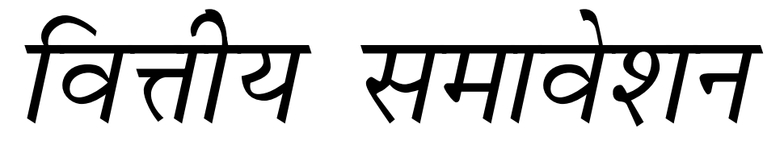
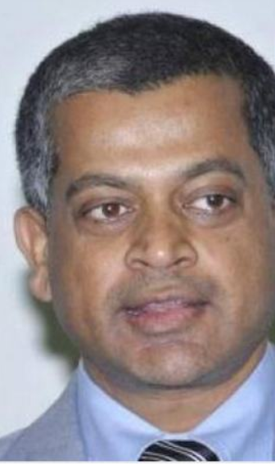
Deepak Mohanty RBI Exe.Dir.
ISS reform
RBI Committee on Med-term path on financial inclusion
$$ diverted to non-agri. Purpose e.g. FD: @~7%; ISS loan @4%=3% profit
Not reaching to small/marginal farmers (Rajan fixed-new PSL 8% quota)
Replace ISS with universal crop insurance subsidy.
Criticism: won’t help, if no MSP procurement, no crop loss.

Slide 100
Deepak Mohanty RBI Exe.Dir.
ISS reform
USSD to deliver banking services to non-smartphones
Sukanya Shiksha scheme for middle school girls to cultivate banking habits
MSME: unique identification # for borrowers => info. sharing. to prevent NPA & loan frauds

Slide 101
Today’s Session: Banking
NPA, TBS, BASEL, 4R, Indradhanush, BBB
MP Incomplete Transmission, MCLR etc.
Differential Banks
PSL-framework, Certi.
Watch L1/P2 to P9
before going further

